Slide 1


Experimental Procedures Training
Things to Consider
The Experimental Procedures Document
Important info

Slide 2
Things to Consider
Never perform a test without approval from team management!
It is always better to be overprepared (and extra safe) rather than marginally prepared
The Experimental Procedures document exists to assure that all necessary information is provided prior to a test being performed.
Procedures are put into place specifically for safety and to maximize our ability to get data

Slide 3
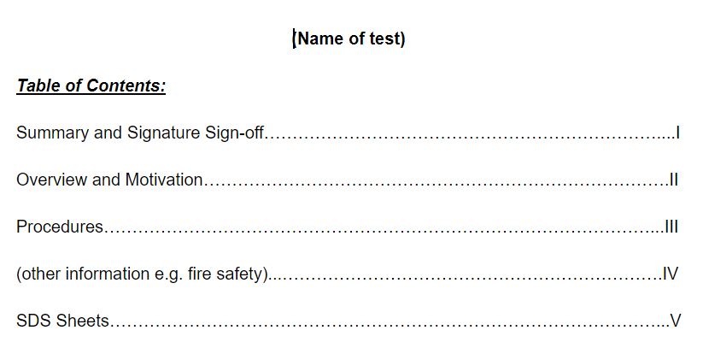
The Experimental Procedures Document
Table of Contents
Fill in the name of the test and other information

Slide 4
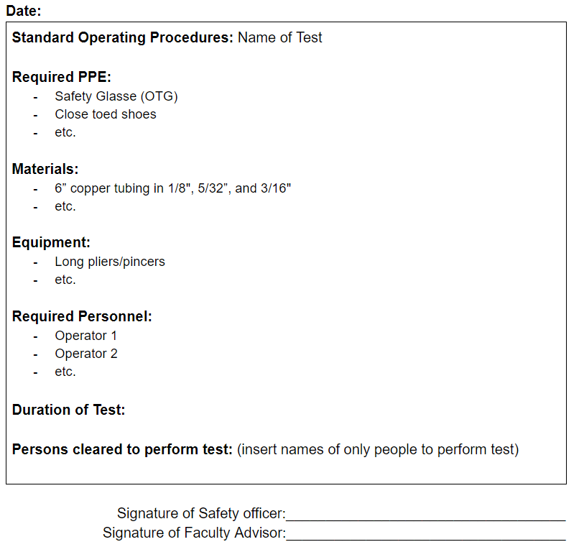
The Experimental Procedures Document
Summary and Signature Sign-off
This page should give a quick synopsis of the experiment and all necessary items and personnel
No need to write out long sentences, bullet points should suffice
Be specific about everything! You may not think twice about something such as close toed shoes, but still important to make note
Duration of Test: we need an estimate of how long the test is expected to be performed
Signatures: Not all tests will require Faculty Advisor Signature, but all will require Safety Officer Signature
ONLY PERSONS WHO HAVE DONE APPROPRIATE TRAINING WILL BE CLEARED TO PERFORM THE TEST

Slide 5
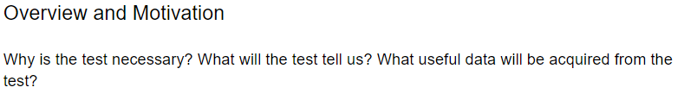
The Experimental Procedures Document
Overview and Motivation
Give a detailed summary of why the test is necessary for our project to perform. How will it progress the project? What will we gain from the test? Why is this the only/best way to obtain this data? Etc.

Slide 6
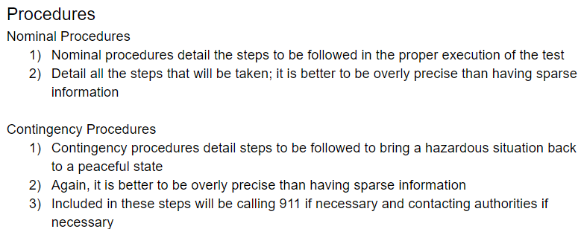
The Experimental Procedures Document
Procedures
Nominal Procedures are the exact procedures to be done to complete the experiment as expected.
These are what we do when all goes as expected
These need to be specific and detailed – do not leave room for interpretation. Write exactly what you want to happen.
Contingency Procedures are the actions to take when something wrong happens and a hazardous or potentially hazardous situation arises.
These NEED to be specific and detailed. Writing out even the simplest steps is important because not everyone will have the same natural reaction to unexpected situations.
Contingency procedures need to be written out to the point where the hazardous situation is brought back to a peaceful state

Slide 7
The Experimental Procedures Document
Additional Information
This will typically include fire safety policy (usually will be able to just reference the team fire safety policy), chemical safety, electrical safety, site-specific information, or other information that could prove useful.
Even though many of these things should be detailed/talked about in previous sections, we also need specific policies for cases such as fires
SD Sheets
Just about every test should have a few SD sheets included. These will be specific for the materials/chemicals used.
Suppliers of the materials should have these on their websites so that we have the specific SDS for the material we are using.
Important to include because they contain important handling and safety information as well.

Slide 8
Important Info
Remember, this document needs to be filled out BEFORE EVERY TEST
Even if the document is filled out, the document needs to be signed and approved before the test can be performed
If you want to perform a test, or think a test is necessary, talk to your team leads! Then try to fill out the document and see if it will really be necessary
Locations of tests are important! Always check with safety officers about the viability of the location before proceeding with the test

